Slide 1
C Programming
www.kharwal.com
Arvind Kharwal
Structure of a C Program

Slide 2
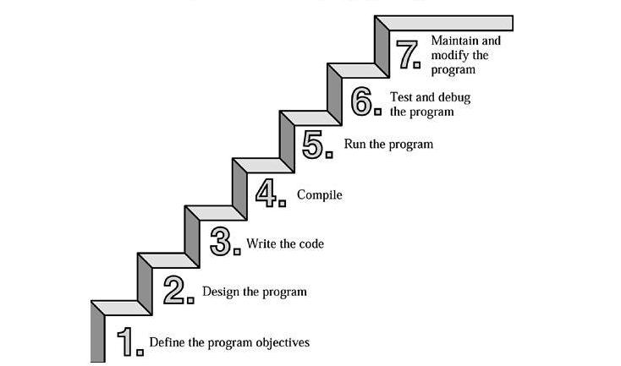

Slide 3
Define the Program Objectives
Design the Program
Write the Code
Compile
Run the Program
Test and Debug the Program
Maintain and Modify the Program

Slide 4
Types of Data Types

Slide 5
Where c used:
Many software houses use C as the preferred language for producing word processing programs, spreadsheets, compilers, and other products

Slide 6
